Slide 1
Zero Trust Cryptographic Confinement for AI
Demo 1: Design Proposal
TEAM
MENTOR
Bharath, Kim, Mabelle, Mitchell, Youwei
Dr. Charles Munson (MIT Lincoln Lab)

Slide 2


The Vulnerability
Failed Perimeters
Actuator Space
Static RBAC policies bypassed easily.
Isolated execution environments.
Semantic manipulation overrides gateways.
Cryptographically enforced human quorum.

Slide 3
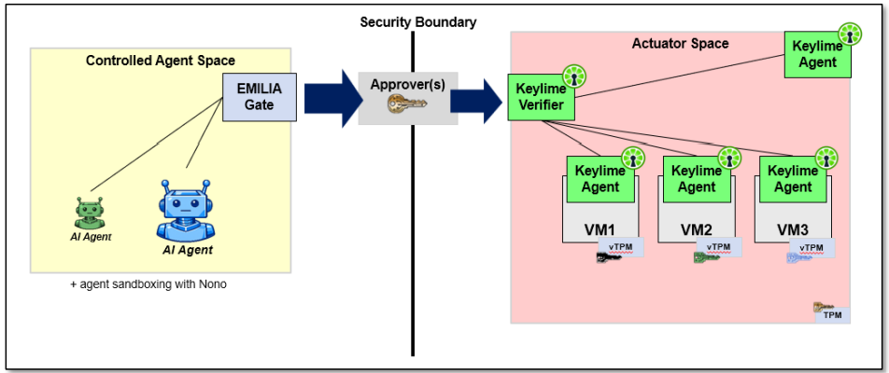
System Architecture
End-to-End Pipeline

Slide 4
The Zero Trust Hand-off
1
2
3
Agent Confinement
Distributed Auth
Attested Execution
Nono sandbox isolates base resources.
EMILIA Gate enforces multisig quorum.
Keylime verifies hardware integrity.

Slide 5

CORE TECHNICAL CHALLENGE
Secure Cross-System Integration
Integrating Nono, Emilia, and Keylime into zero-trust pipeline
Authorization must be cryptographically verifiable before execution
Execution must occur only on a successfully attested actuator

Slide 6
Verifiable Milestones
Demo 2 — Oct 21
Demo 3 — Nov 16
Final — Dec 09
Infrastructure + Authorization
Real Agent + Human & Handoff
End-to-End
MOC VMs running with Keylime Agent attestation.
Emilia Gate successfully intercepting requests
Nono confined agent requests deployment with human authorization
Authorization -> Keylime Attestation handoff functions correctly
Full cryptographic handoff executed automatically.

Slide 7


Measuring Success
A functional pipeline where an AI request is paused, signed by a multisig quorum, and securely deployed.
Authorized tasks execute.
Unauthorized tasks blocked.
QUESTIONS?

